Slide 1
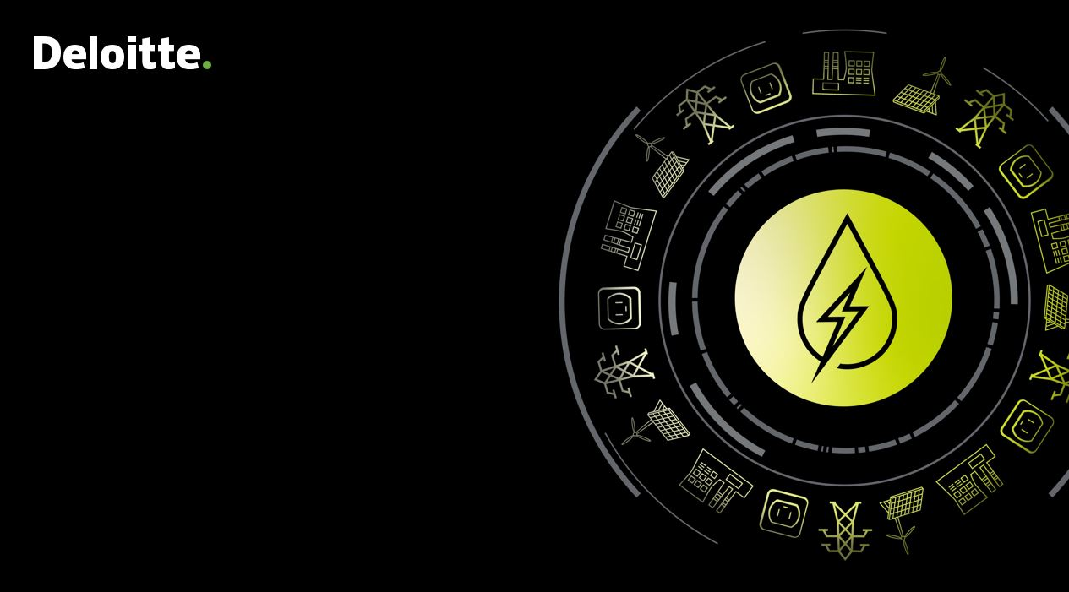
Draft Report
Global & Indian Power/Energy Sector Outlook
Strategic planning and transformation of the West Bengal Power Sector
Department of Power, Government of West Bengal
Deloitte Touche Tohmatsu India LLP, July 2022
Notes:
To be picked from https://consulting.deloitteresources.com/brand/Pages/Imagery.aspx
https://brandspace.deloitte.com/content/index/guid/image_library?search_term=&list_size=25&assettag%5B16%5D%5B%5D=43&assettag%5B19%5D%5B%5D=50

Slide 2
Contents
1
XXXXXX
2
3
4
5
6
7
8
9

Slide 3
Global Scenario
1

Slide 4
Demand Supply Scenario
1.1

Slide 5
XXXXX

Slide 6
Energy Basket
1.2

Slide 7
Consumer Segment
1.3

Slide 8
Global trends in Sustainable Energy Segment
1.4

Slide 9
Case studies - Impact of Government Interventions
1.5

Slide 10
Grid of Future
1.6

Slide 11
Energy Efficiency Initiatives
1.7

Slide 12
Indian Scenario
2

Slide 13
Demand Supply Scenario
2.1

Slide 14
Energy Basket
2.2

Slide 15
Consumer Segment
2.3

Slide 16
Impact of Government Interventions
2.4

Slide 17
Grid of Future
2.5

Slide 18
Green Open Access
2.6

Slide 19
Transfer of 66 kV assets from DISCOM to PGCIL
2.7

Slide 20
Consumer Rights
2.8

Slide 21

Deloitte refers to one or more of Deloitte Touche Tohmatsu Limited, a UK private company limited by guarantee (“DTTL”), its network of member firms, and their related entities. DTTL and each of its member firms are legally separate and independent entities. DTTL (also referred to as “Deloitte Global”) does not provide services to clients. Please see www.deloitte.com/about for a more detailed description of DTTL and its member firms.
This material has been prepared by Deloitte Touche Tohmatsu India LLP (“DTTILLP”), a member of Deloitte Touche Tohmatsu Limited, on a specific request from you and contains proprietary and confidential information. This material may contain information sourced from publicly available information or other third party sources. DTTILLP does not independently verify any such sources and is not responsible for any loss whatsoever caused due to reliance placed on information sourced from such sources. The information contained in this material is intended solely for you. Any disclosure, copying or further distribution of this material or its contents is strictly prohibited.
Nothing in this material creates any contractual relationship between DTTILLP and you. Any mutually binding legal obligationsorrights may only be created between you and DTTILLP upon execution of a legally binding contract. By using this material and any information contained in it, the user accepts this entire notice and terms of use.
©2022 Deloitte Touche Tohmatsu India LLP. Member of Deloitte Touche Tohmatsu Limited
Deloitte Touche Tohmatsu India Private Limited (U74140MH199 5PTC093339), a private company limited by shares, was converted into Deloitte Touche Tohmatsu India LLP, a limited liability partnership (LLP Identification No. AAE-8458),with effect from October 1, 2015.

